Slide 1
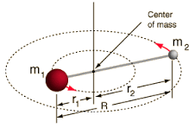
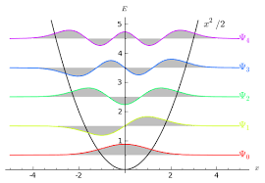
Lectures 12-13. Molecular Spectroscopy: Bond Length and Bond Strength

Slide 2
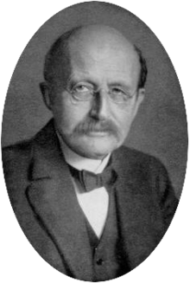
Quantum Chemistry
Wave mechanics; operators
Boundary conditions: Quantum numbers
Eigenvalues and expectation values
Hydrogen atom
Multielectron atoms
Molecules: VBT, MOT
Bond length, energy, etc.
Fact or fiction?
Experiments are the only means of knowledge at our disposal. The rest is poetry, imagination.

Slide 3
Molecular Spectroscopy
Interaction of radiation with matter
Ionization energies
Bond Length
Bond Strength
Intermolecular interactions
Functional groups
Structure in solution
Dynamics
Experiments are the only means of knowledge at our disposal. The rest is poetry, imagination.

Slide 4
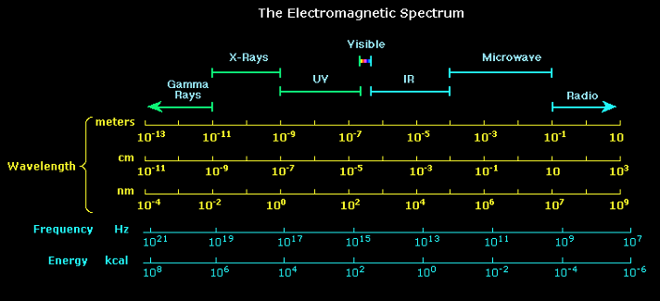
Electromagnetic Spectrum

Slide 5
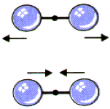
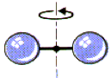
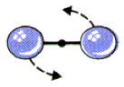
Spectroscopy: Quantum Mechanics in action
UV-Visible
IR
Microwave
Energy (ΔE)
10² kcal
1 kcal
10⁻² kcal
Frequency
10¹⁵ Hz
10¹² Hz
10⁹ Hz
Time scale
10⁻¹⁵ s
10⁻¹² s
10⁻⁹ s
Electronic motion
Nuclear motion
Vibrational motion
Rotational motion
Bond strength
Bond length

Slide 6
Important Molecular Properties for Spectroscopy:
1. Dipole moment
H
Cl
μ_{b1}
μ
O
+ q
μ_{b2}
+
H
l
Cl
μ_{b}
-
- q
μ
θ
μ_{b}
O
C
O
Cl
Cl
In chemistry, the direction of dipole moment is from positive to negative

Slide 7
Important Molecular Properties for Spectroscopy:
2. Polarizability
For strong fields:
β → Hyperpolarizability; γ →2nd order hyperpolarizability
Induced dipole moment in a atom or molecule due to the polarization of charge distribution
α: extent to which a charge distribution around an atom or a molecule can be distorted in presence on an uniform electric field (due to ion, another dipole)
Loosely relate polarizability to volume → units of volume!

Slide 8
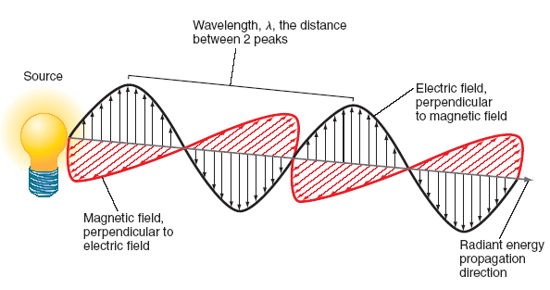
How radiation and matter interact
Oscillating permanent dipole moment: oscillating field
Heteronuclear diatomics: HCl
Polar multielectronic molecules: H₂O
Fluctuating induced dipole moment
Homonuclear diatomics: H₂,
Heteronuclear non-polar molecules: like CO₂

Slide 9
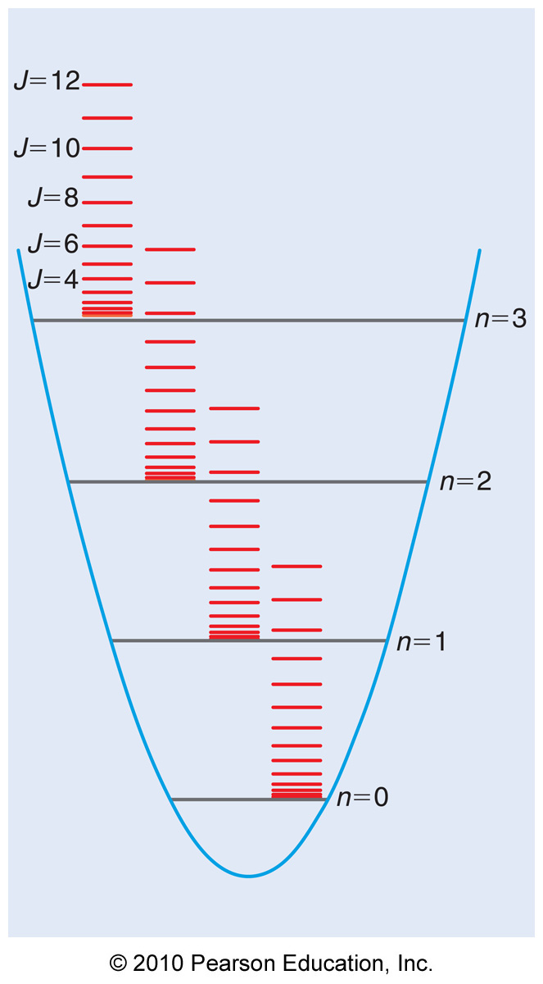
Energy Levels within a molecule
Born-Oppenheimer Approximation
The motion of atomic nuclei and electrons
in a molecule can be separated

Slide 10
The information contained in a spectrum
E₃
40 cm⁻¹
Intensity
E₂
20 cm⁻¹
0
10
20
30
10 cm⁻¹
Energy of transition
E₁
Probability of transition:
Transition Dipole Moment/ Transition Moment Integral
Selection rules (can be derived using QM calculations)
Population of states (Boltzmann Distribution)
No. of molecules in level j at equilibrium

Slide 11
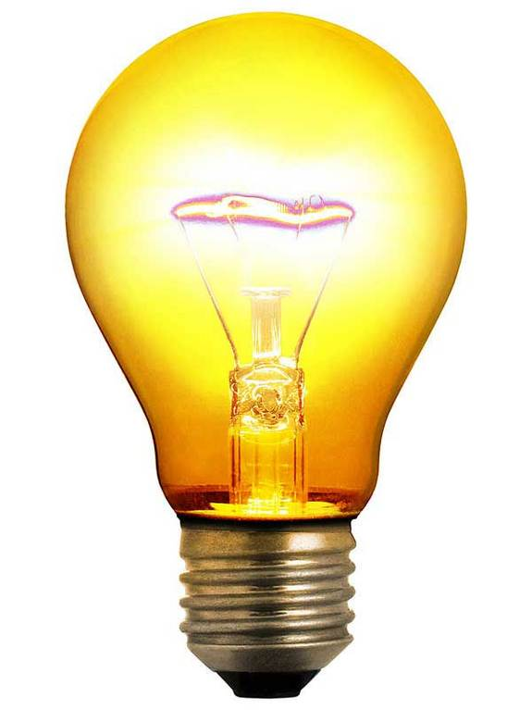
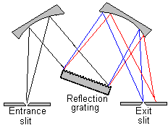

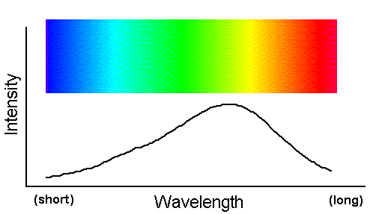
Schematics of a spectrophotometer
Monochromator
A= log I₀/I
Beam Splitter
Sample
Reference

Slide 12
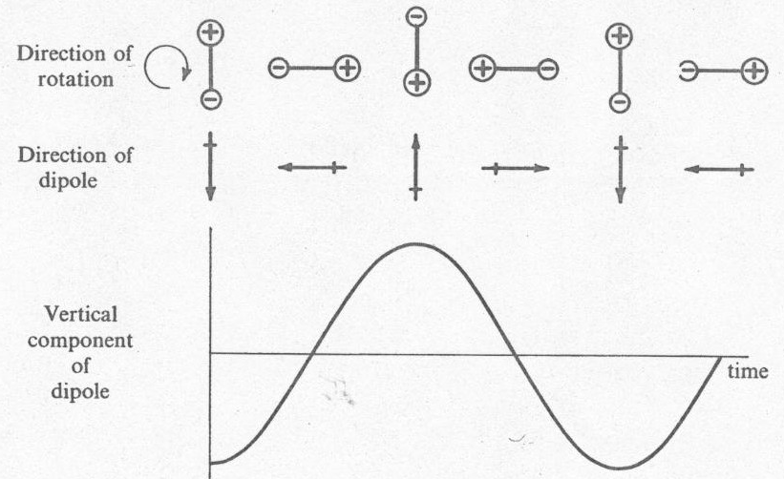
Rotation of HCl
A diatomic molecule with permanent dipole moment
Rotational motion: fluctuating dipole along z-direction
HCl is microwave active

Slide 13
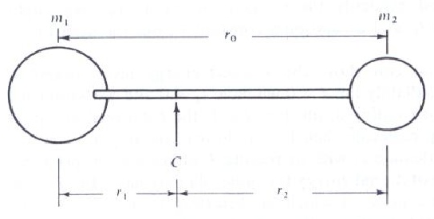
Rigid Rotor model
Assumption: The bond length does not change during rotation
μ
r₀
Cl
H
Schrödinger Equation: Hamiltonian in (Θ, ϕ)
Wavefunctions: Spherical harmonics, same as in H atom

Slide 14
Rotational transition energies (ΔE)
Selection Rule:

Slide 15
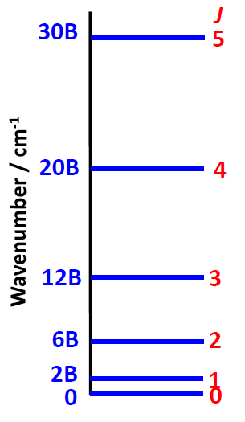
Rotational Spectra: Microwave
2B
Intensity
2B
2B
2B
2B
2B
0
2B
4B
6B
8B
10B
12B
14B
Wavenumber (in cm⁻¹)
Rotational spectral lines are all equally spaced
Spectral lines go through a maximum
Rotational energy levels get more widely spaced with increasing J
Why?

Slide 16
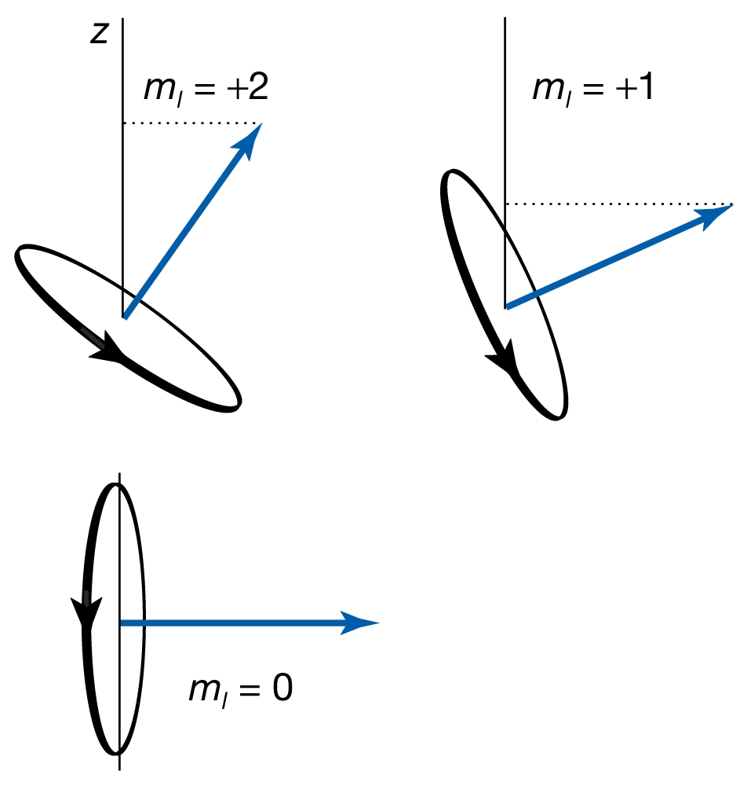
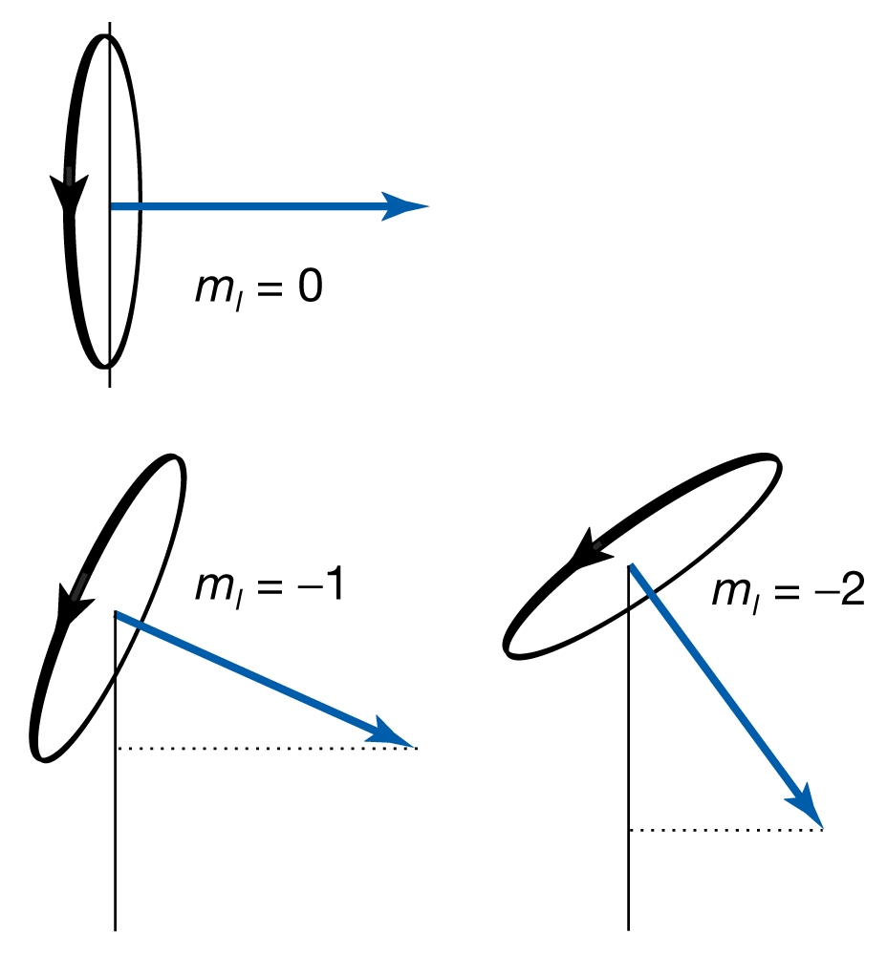
Rotational Spectra: Microwave
Degeneracy, g_{j} = 2J + 1
2B
Intensity
2B
2B
2B
2B
2B
0
2B
4B
6B
8B
10B
12B
14B
Wavenumber (in cm⁻¹)

Slide 17
Rotational Spectra: Microwave
Degeneracy, g_{j} = 2J + 1
2B
Boltzmann distribution:
Intensity
2B
2B
2B
2B
2B
0
2B
4B
6B
8B
10B
12B
14B
Wavenumber (in cm⁻¹)

Slide 18
Rotational Spectra: Microwave
Degeneracy, g_{j} = 2J + 1
2B
Boltzmann distribution:
Intensity
2B
2B
2B
2B
2B
0
2B
4B
6B
8B
10B
12B
14B
Wavenumber (in cm⁻¹)
Find an expression for J for which the population is maximum

Slide 19
Rotational Spectra: Information
Degeneracy, g_{j} = 2J + 1
2B
Boltzmann distribution:
Intensity
2B
2B
2B
2B
2B
0
2B
4B
6B
8B
10B
12B
14B
Wavenumber (in cm⁻¹)
Bond length

Slide 20
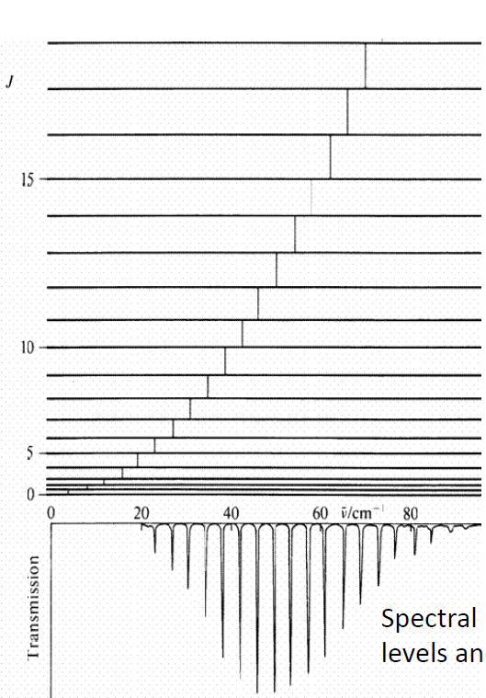
A real rotational spectra: CO

Slide 21
Rotational spectroscopy: Applications
Microwave oven
Astrophysics
Analysis of materials

Slide 22
Bond strength
HCl: A diatomic molecule with permanent dipole moment
Basic assumption:
The bond between two atom behaves like spring
Harmonic oscillator approximation: Hooke’s Law
F = – k(r – r_{eq}) k is the force constant
E_{PE} = ½ k (r – r_{eq})²

Slide 23
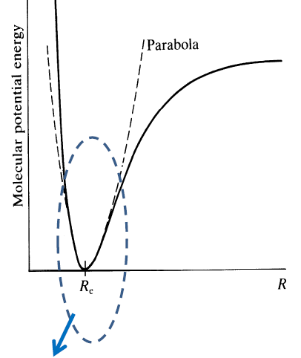
The chemical bond as a simple harmonic oscillator
SHO: a good approximation
for small displacements
Notes:
Please mention about selection rule

Slide 24
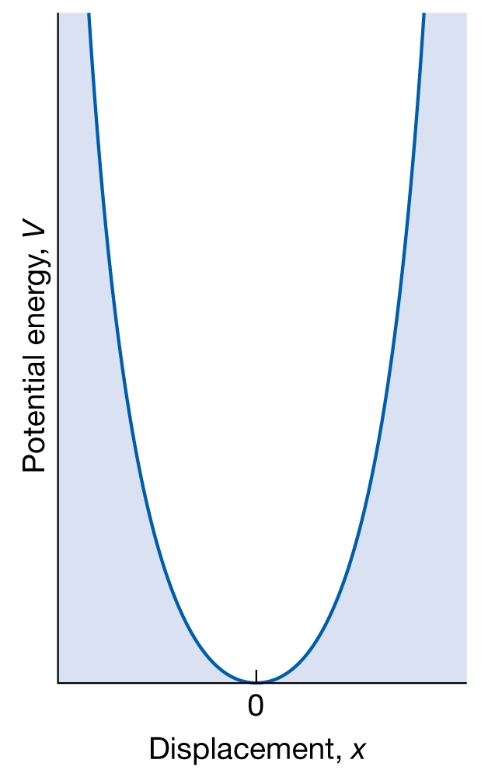
The chemical bond as a simple harmonic oscillator
Parabolic potential:
Schrödinger equation:
Boundary condition:
ψ = 0 at x = + ∞
SHO: a good approximation
for small displacements
Notes:
Please mention about selection rule

Slide 25
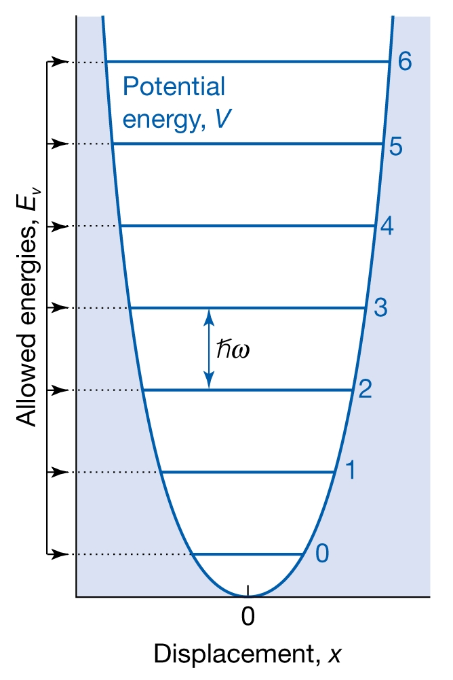
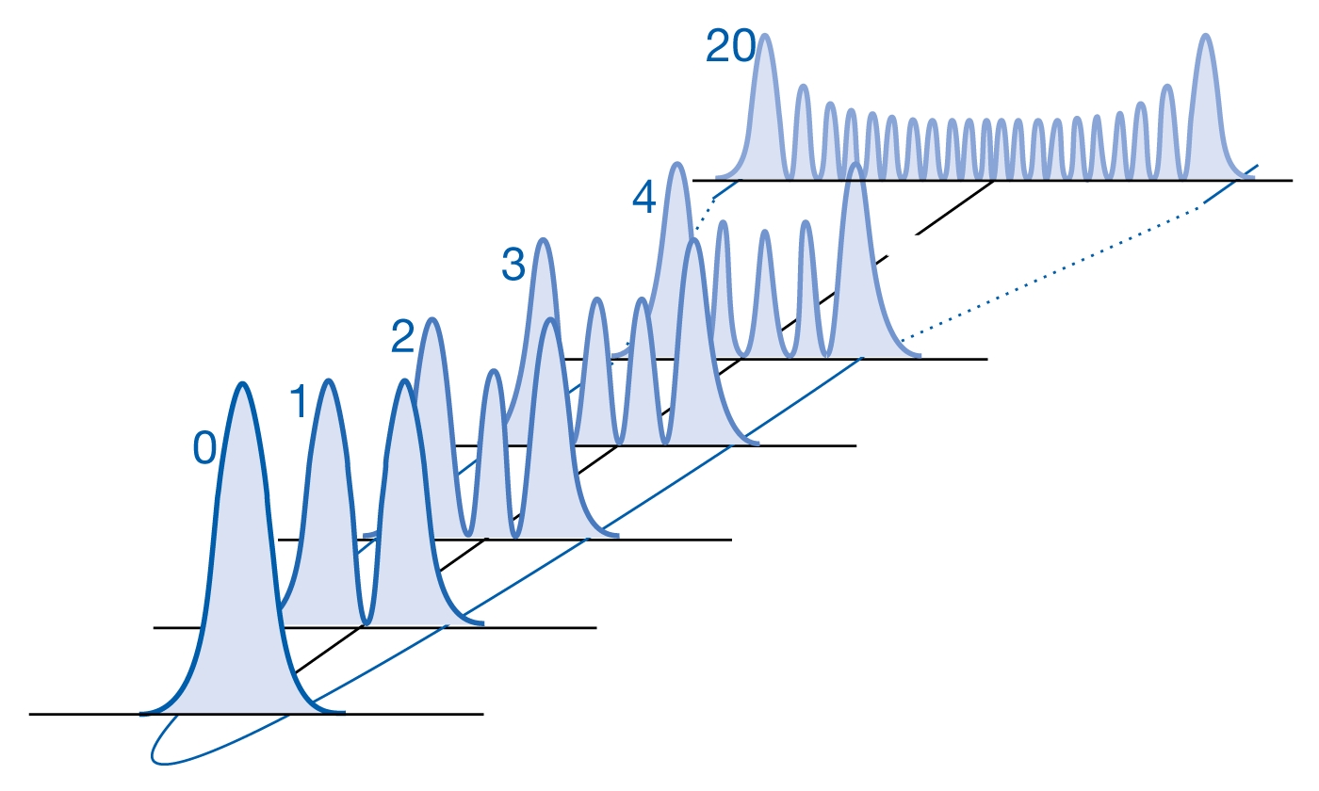
The chemical bond as a simple harmonic oscillator
Parabolic potential:
Schrödinger equation:
Boundary condition:
ψ = 0 at x = + ∞
E_{v} = (v + ½)ħω
SHO: a good approximation
for small displacements
Notes:
Please mention about selection rule

Slide 26
The chemical bond as a simple harmonic oscillator
v = Vibrational quantum number
= 0, 1, 2, 3, …
Force constant
Reduced mass
E_{v+1} – E_{v} =
ħω
= hω/2π
= hν
E_{v} = (v + ½)ħω
E_{v=0} = ½ħω
Zero point energy
Notes:
Please mention about selection rule

Slide 27
The chemical bond as a simple harmonic oscillator
v = Vibrational quantum number
= 0, 1, 2, 3, …
Force constant
Reduced mass
E_{v+1} – E_{v} =
ħω
= hω/2π
= hν
E_{v=0} = ½ħω
Zero point energy
Notes:
Please mention about selection rule

Slide 28
Spectrum of a harmonic oscillator
v = Vibrational quantum number
= 0, 1, 2, 3, …
Δv=1
Force constant
Intensity
Reduced mass
E_{v+1} – E_{v} =
ħω
0
1000
2000
3000
= hω/2π
= hν
Energy of transition
IR Spectrum:
Bond strength
Polyatomic molecule: Different Bond strengths
➔ Functional groups
Notes:
Please mention about selection rule

Slide 29
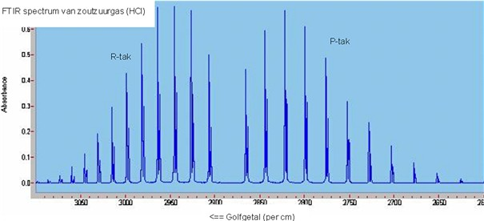
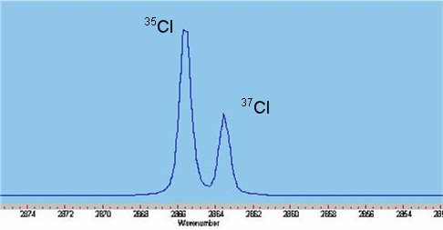
High resolution IR spectrum of HCl
Rotational fine structure
Δv=1, ΔJ=+1
Isotope effect

